Slide 1
Experiencing A11y
An Intro to Web Accessibility
@SheWrestlesTest
Notes:
Chels

Slide 2
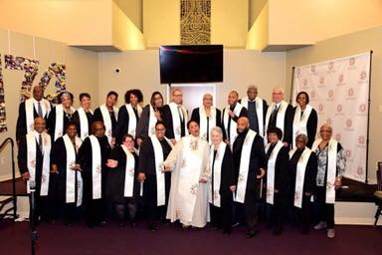
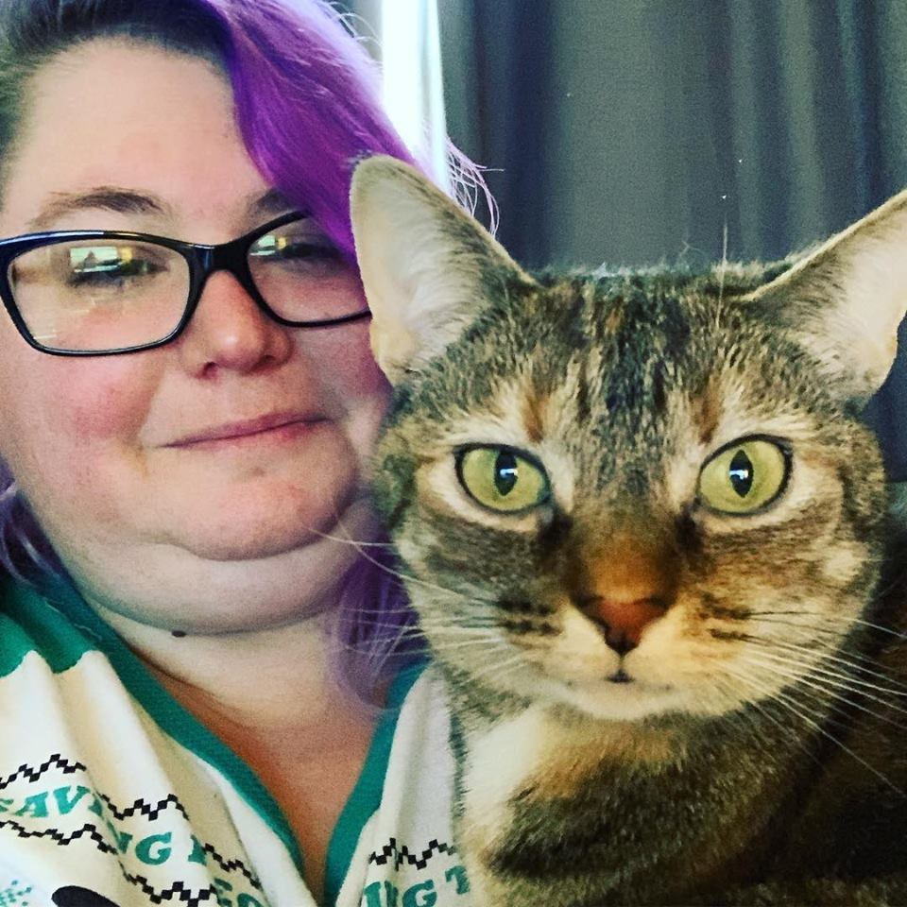
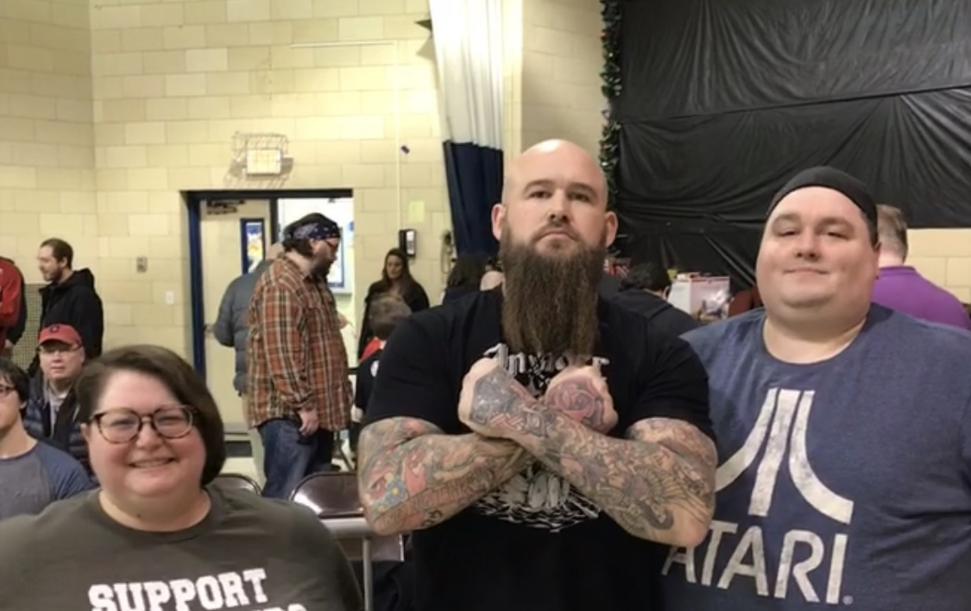

About Me
8 years in testing
Cat mom, married to cat dad
Deacon
Pro Wrestling
@SheWrestlesTest

Slide 3
a11y?
Accessibility (a11y) is a measure of a computer system's accessibility to all people, including those with disabilities or impairments. It concerns both software and hardware and how they are configured in order to enable a disabled or impaired person to use that computer system successfully.*https://www.techopedia.com/definition/10165/accessibility-a11y
Accessibility is also known as assistive technology
Accessibility makes an application inclusive to all potential users
Accessibility creates better UX for all users
@SheWrestlesTest
Notes:
Chels

Slide 4
Why do you think accessibility matters?
@SheWrestlesTest
Notes:
Chels

Slide 5
Why Does Accessibility Matter
Reach more customers
The right thing to do
Potential legal risks
Must be Web Content Accessibility Guidelines (WCAG) compliant
Notes:
Chels

Slide 6

What is WCAG?
A set of requirements that defines how to make Web Content more accessible
Created by the W3C’s Web Accessibility Initiative
Relevant laws include, but are not limited to:
The Americans with Disabilities Act (ADA)
Rehabilitation Act of 1973
@SheWrestlesTest

Slide 7
WCAG (2.1) Structure
Principals
POUR
Perceivable
1. Perceivable
Operable
2. Operable
Understandable
3. Understandable
Robust
4. Robust
@SheWrestlesTest
Notes:
Chels
Guidelines and Success Criteria are real examples.
Principal 1: Perceivable
Information and user interface components must be presentable to users in ways they can perceive.
They need to be able to input the information into their brain so that they can process it
Principal 2: Operable
User interface components and navigation must be operable.
Users should be able to find, navigate through, and interact with web content
Principal 3: Understandable
Information and the operation of user interface must be understandable.
Principal 4: Robust
Content must be robust enough that it can be interpreted reliably by a wide variety of user agents, including assistive technologies.
Users should be allowed to choose their own technologies to access web content.

Slide 8
WCAG (2.1) Structure
Principals
POUR
Perceivable
1. Perceivable
Guidelines (4)
1.1 Text Alternatives
Operable
2. Operable
Understandable
3. Understandable
Robust
4. Robust
Guidelines (3)
3.2 Predictable
Guidelines (1)
4.1 Compatible
Guidelines (5)
2.2 Enough Time
@SheWrestlesTest
Notes:
Chels
Guidelines and Success Criteria are real examples.
Principal 1: Perceivable
Information and user interface components must be presentable to users in ways they can perceive.
They need to be able to input the information into their brain so that they can process it
Principal 2: Operable
User interface components and navigation must be operable.
Users should be able to find, navigate through, and interact with web content
Principal 3: Understandable
Information and the operation of user interface must be understandable.
Principal 4: Robust
Content must be robust enough that it can be interpreted reliably by a wide variety of user agents, including assistive technologies.
Users should be allowed to choose their own technologies to access web content.

Slide 9
WCAG (2.1) Structure
Principals
POUR
Perceivable
1. Perceivable
Guidelines (4)
1.1 Text Alternatives
Success Criteria
1.1.1 Non-Text Content (Level A)
Operable
2. Operable
Understandable
3. Understandable
Robust
4. Robust
Guidelines (3)
3.2 Predictable
Guidelines (1)
4.1 Compatible
Success Criteria
2.2.3 No Timing (Level AAA)
Guidelines (5)
2.2 Enough Time
Success Criteria
3.2.4 Consistent Identification (Level AA)
Success Criteria
4.1.1 Parsing (Level A)
Notes:
Chels
Guidelines and Success Criteria are real examples.
Principal 1: Perceivable
Information and user interface components must be presentable to users in ways they can perceive.
They need to be able to input the information into their brain so that they can process it
Principal 2: Operable
User interface components and navigation must be operable.
Users should be able to find, navigate through, and interact with web content
Principal 3: Understandable
Information and the operation of user interface must be understandable.
Principal 4: Robust
Content must be robust enough that it can be interpreted reliably by a wide variety of user agents, including assistive technologies.
Users should be allowed to choose their own technologies to access web content.

Slide 10
WCAG Conformance Levels
Level A: Minimum level of conformance (Must)
Level AA: Enhanced level of conformance (Should)
Level AAA: Best level of conformance (May)
A
AA
AAA
@SheWrestlesTest
Notes:
Chels

Slide 11
WCAG 2.1
WCAG 2.0 success criteria to conformance levels modified
Focused on improving accessibility guidance for 3 major groups:
Users with Cognitive or Learning disabilities
Users with low vision
Users with disabilities on mobile devices
WCAG “Silver” under development
@SheWrestlesTest
Notes:
Chels
https://www.w3.org/WAI/standards-guidelines/wcag/new-in-21/

Slide 12
Keeping up with the trends
Law Office of Lainey Feingold
Leading law firm in accessibility
https://www.lflegal.com/
WebAIM
Leaders in accessibility
Site has reference docs and training
https://webaim.org/
@SheWrestlesTest
Notes:
Chels

Slide 13
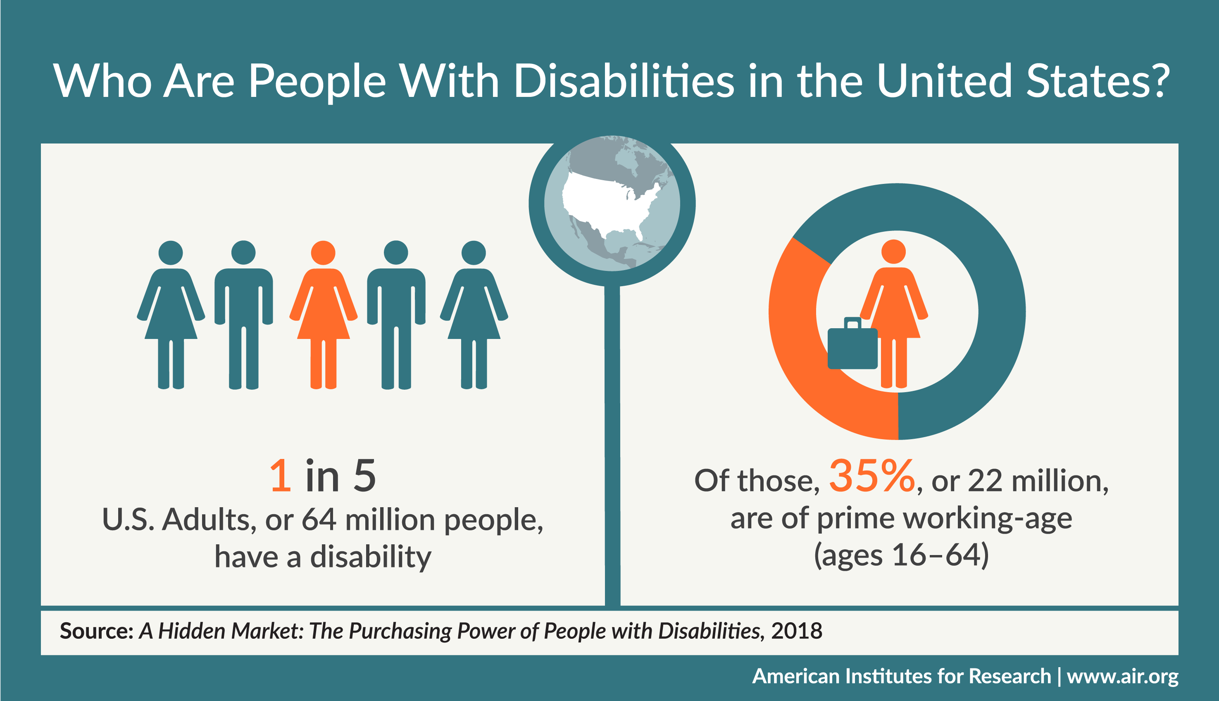
@SheWrestlesTest
Notes:
Jenna

Slide 14
What disabilities can cause barriers in using the web?
@SheWrestlesTest
Notes:
Jenna

Slide 15
Diversity of disabled users
Cognitive/ Learning/ Neurological
Visual and Auditory
Physical
Blind
Reduced or low vision
Color blindness
Deaf
Hearing loss
Amputation
Arthritis
Fibromyalgia
Reduced Dexterity
Muscular Dystrophy
Tremors and Spasms
Paralysis
ADHD
Autism Spectrum Disorder (ASD)
Intellectual Disabilities
Learning Disabilities
Mental Health Challenges
Memory Impairments
Multiple Sclerosis (MS)
Seizure Disorders
@SheWrestlesTest
Notes:
Jenna

Slide 16
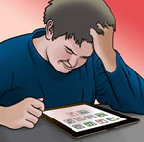
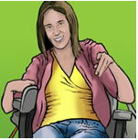


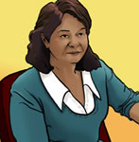
User Personas
Luke
Sarah
Mike
Victor
Maria
High school student
Autism Spectrum Disorder (ASD)
Likes video games
Poor social skills
Difficulty with visual comprehension
College student
Has cerebral palsy
Uses mobility scooter
Uses computer for communication
Paralegal
Blind since birth
Proficient with technology
Uses screen readers
Engineer
Low vision due to glaucoma
Uses screen readers and contrast adjustment
Community health worker
Late adopter. Mobile phone was her first computer
ESL primary language Spanish
Uses computer translations, needs clearly written information
@SheWrestlesTest
Notes:
Jenna

Slide 17

Accessibility Baked In
@SheWrestlesTest
Notes:
Jenna

Slide 18
Accessibility vs Inclusive Design PS: Inclusive design wins
Accessibility
Inclusive Design
Typically an after thought
Fixing symptoms not root cause
Accessibility is central to design
Improves experience for all users
Less compliance fixes needed
@SheWrestlesTest
Notes:
Jenna

Slide 19
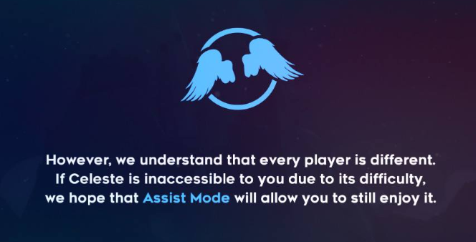
Accessibility should be central to your application development
Celeste
Reduce difficulty
Reduce speed
Infinite lives
Remove screen shake
Remove strobe
Change button configuration
@SheWrestlesTest
Notes:
Jenna

Slide 20

Notes:
Jenna

Slide 21
What To Test
Test all the things
Keyboard only
Screen reader
Mobile
Color Contrast
Screen magnification
Time out
Subtitles
Animations
Flash
Natural voice alternatives
Use your instincts
Does it feel like a user would struggle? Bring it up!
@SheWrestlesTest

Slide 22
Automation Options
aXe-Core
Deque
Tenon.io
Web Accessibility Checker
ASP.Net
A11y Machine
Tanaguru
Pa11y
Apple’s Accessibility API’s
@SheWrestlesTest

Slide 23
Browser Add Ons
Accessibility Developer Tools
Chrome
Chrome Audit
Chrome
WAVE Evaluation Tool
Chrome
Accessibility Evaluation Toolbar
Firefox
ANDI
All browsers
Created by Social Security Administration
@SheWrestlesTest

Slide 24
Other Useful Tools
Color Oracle
Simulates color blindness
Snook Color Contrast
Evaluates contrast ratio
Provides WCAG score
JAWS Inspect
Inspect tool for screen readers
ZoomText
Screen magnifier
Browser add on high contrast simulator
@SheWrestlesTest

Slide 25
Key Takeaways
WCAG Guidelines
Accessibility baked in from inception
Accessibility improves an application for all users, not just disabled users
Diversity of disabled community
User personas guide our testing and development
“Nothing for us, without us”
@SheWrestlesTest
Notes:
Chels

Slide 26
Resources
Web Accessibility Initiative- https://www.w3.org/WAI/
User Personas- https://rosenfeldmedia.com/a-web-for-everyone/personas-for-accessible-ux/
Web Accessibility Automation Tool- https://www.axe-core.org/
Switch Demo- https://www.youtube.com/watch?v=5btytT9SPA4
Snooks color contrast-https://snook.ca/technical/colour_contrast/colour.html#fg=FFFFFF,bg=D51D7E
a11y- https://www.techopedia.com/definition/10165/accessibility-a11y
Number of disabled users- https://www.air.org/news/press-release/meeting-needs-adults-disabilities-marketplace
WCAG Standards - https://www.w3.org/WAI/standards-guidelines/wcag/
@SheWrestlesTest
Notes:
Chels

